Slide 1
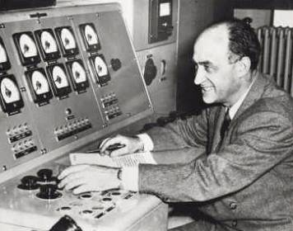
Enrico Fermi (1901 – 1954)
One of the leaders of Modern Physics
  Created the first nuclear reactor
Had a knack for asking and
answering the “Big Questions”
  E.g. Fermi Paradox
Was good at making “Educated Guesses”
  Fermi Questions

Slide 2
Fermi Questions - Example
Question:
  What is the total mass in kilograms of all students in the school?
Educated Guess (Answer):
  What are the variables that influence the answer?
  What do we know (exactly or approximately) about those variables?
  Can we improve our estimated values?

